Slide 1
Data Flow Diagrams
of
DONORS CHOOSE

Slide 2
Group Members
180041208
Fida Kamal
180041214
Fariha Fairoz Nohan
180041229
Alvi Aveen Khan
‹#›/7

Slide 3
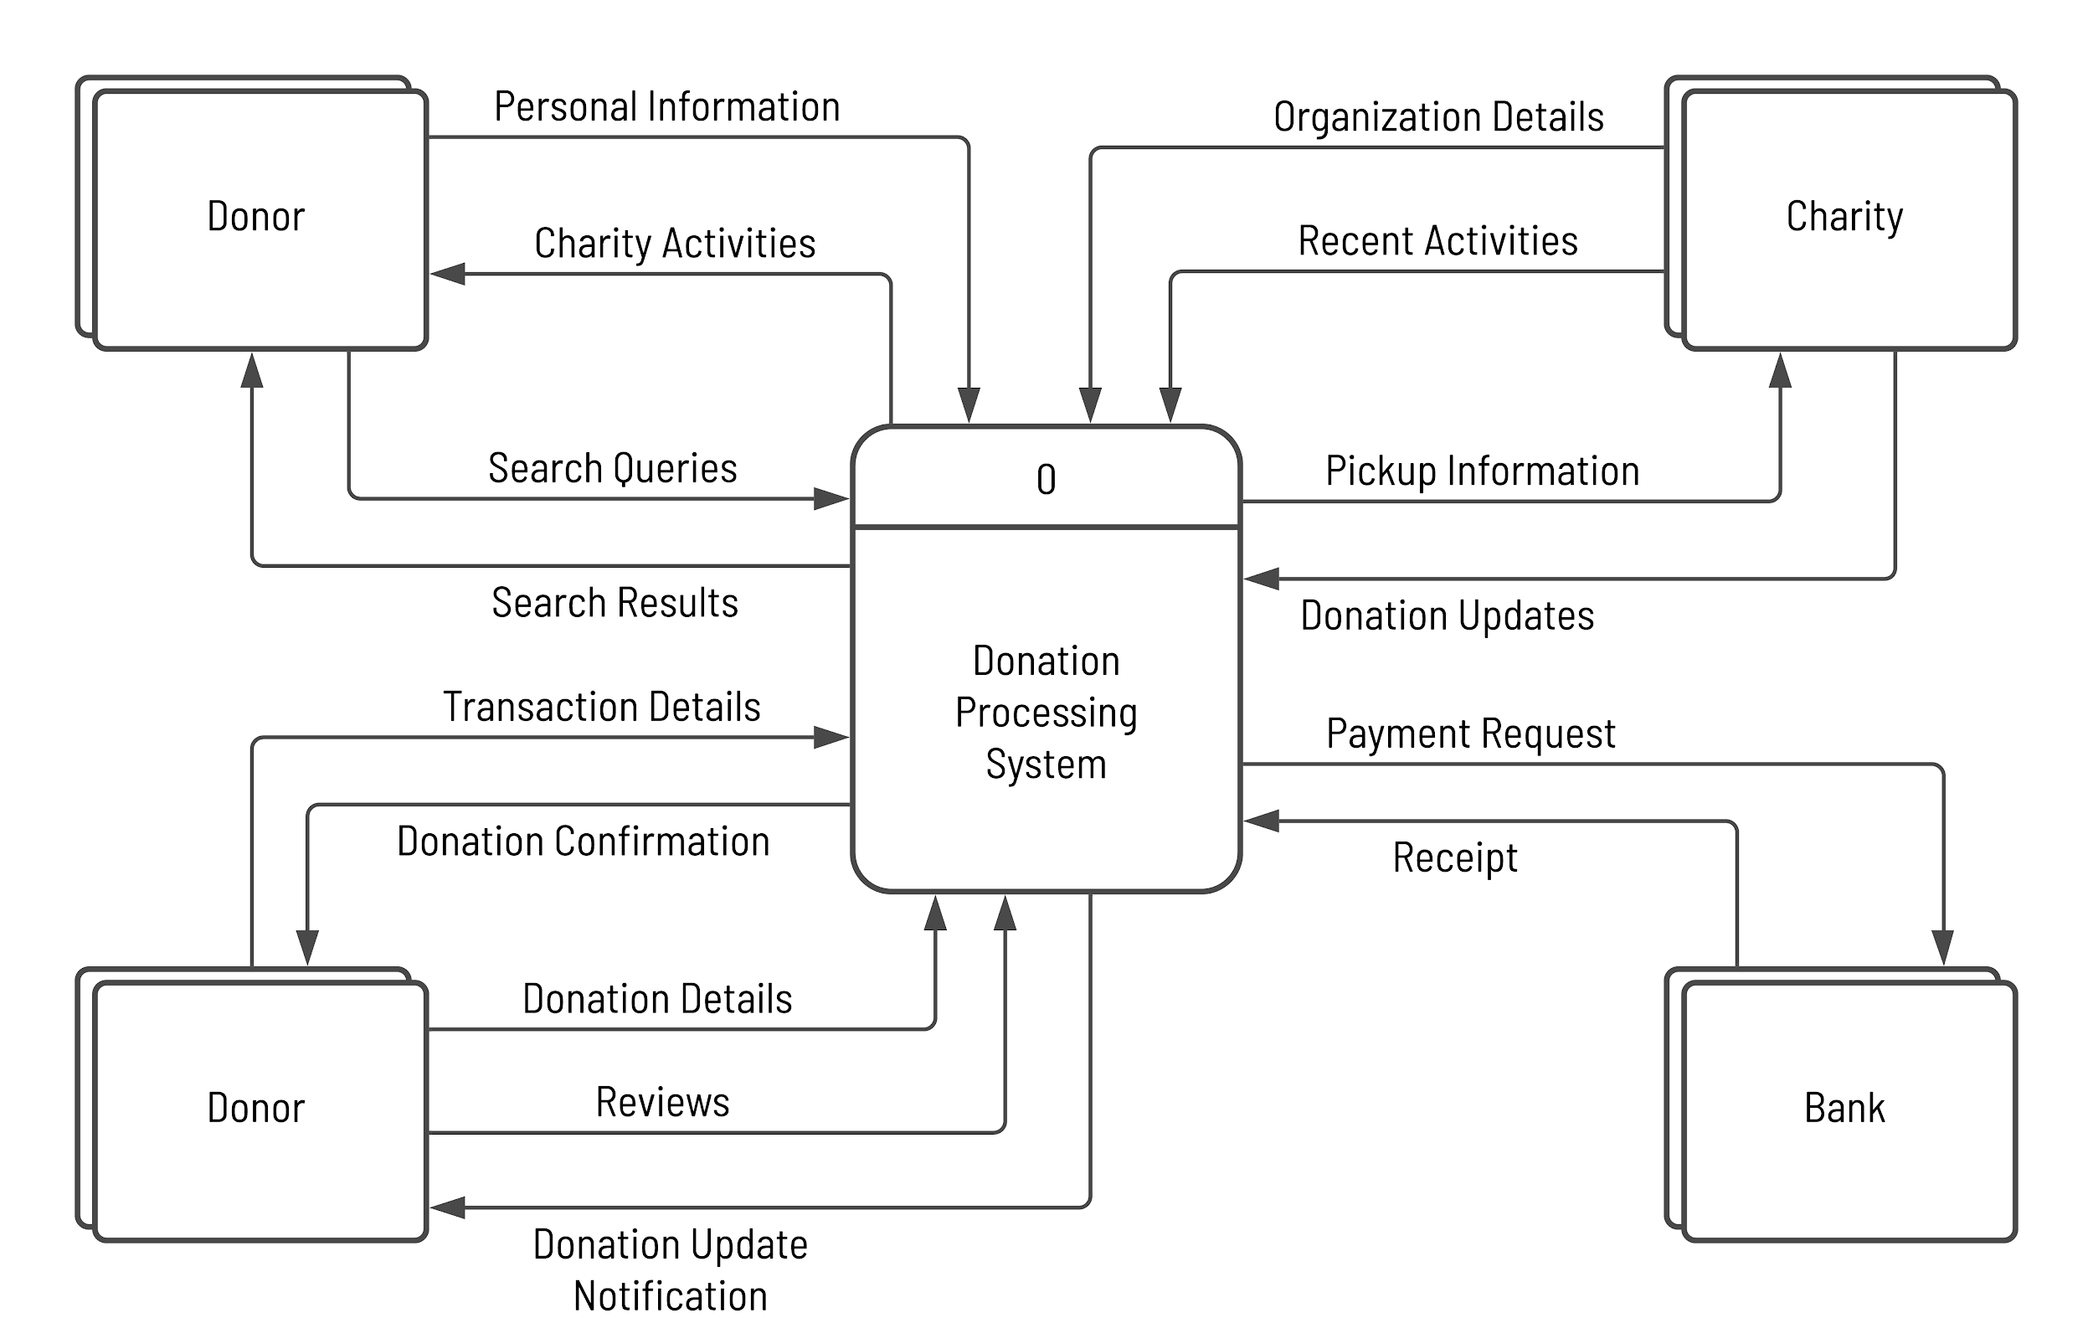
Context Diagram
‹#›/7

Slide 4
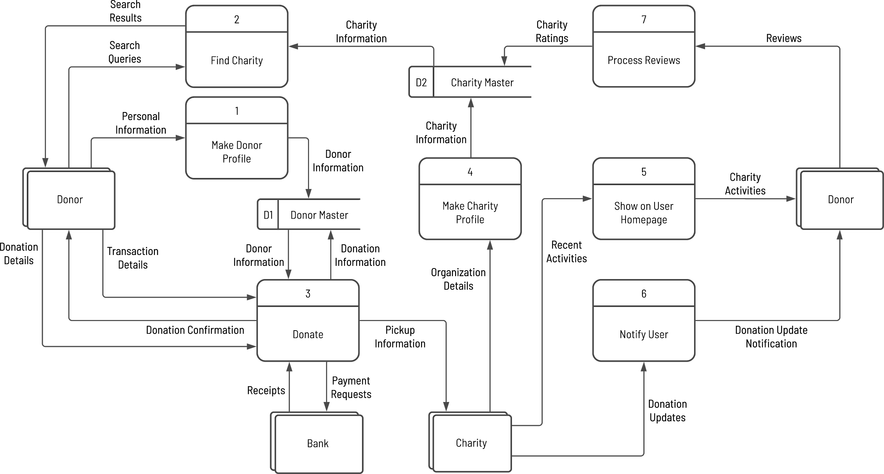
Diagram 0
‹#›/7

Slide 5
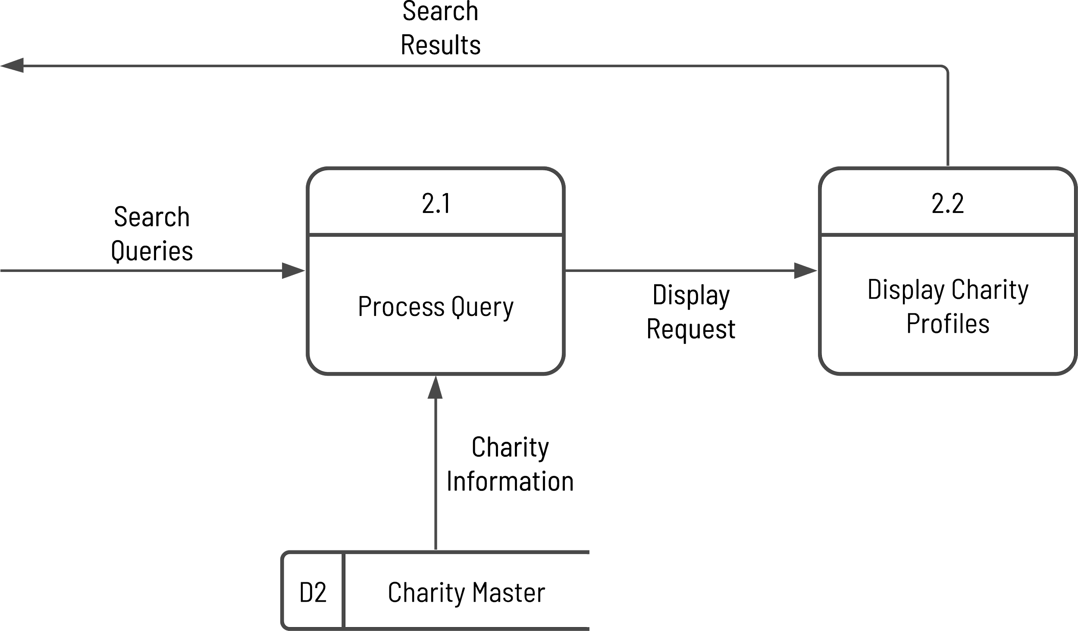
Diagram 2
‹#›/7

Slide 6
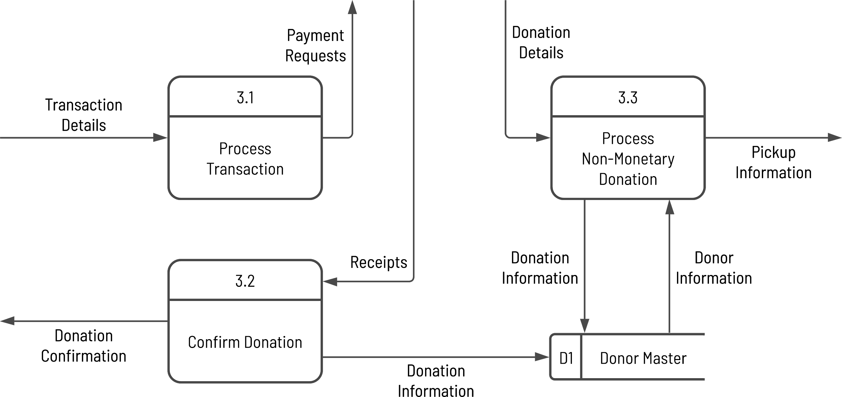
Diagram 3
‹#›/7

Slide 7
THANK YOU!

